Slide 1


GCSEPod
Using the Question Bank and Boost Playlist Features

Slide 2
In Summary
Question Bank
Boost Playlists
GCSEPod now has a bank of over 18,000 community questions written by teaching professionals in the GCSEPod community.
Choose the questions you like, edit them to your needs, and create your assignment in seconds.
Add your own questions to the bank so others can benefit from your expert knowledge.
Each question in the bank is tied to relevant Pods. Incorrectly answered questions first identify the knowledge gap.
Then, a personalised Boost playlist is automatically generated based on students’ weaker areas.
Boost playlists are generated for any assignment you create, including questions you've written yourself.

Slide 3

The Possible Results of Using These Features:
“GCSEPod has been fully embedded into schemes of learning.
“Staff worked in teams to include GCSEPod in lesson plans, utilise it for flipped learning and as a homework task. GCSEPod has become a large part of our day to day teaching practices and it has never felt like a bolt on.
“By working together, we have simultaneously decreased workload whilst increasing the quality and richness of lessons within the school.”
Dr. Kevin Hylands, Principal, The George Eliot School

Slide 4

How it works
SET AN ASSIGNMENT
TEACHER
VIEWS
REPORT
KNOWLEDGE GAPS
FOUND
BOOST PLAYLIST
FILLS GAPS

Slide 5

Step by Step – Setting an assignment
Select the Pods you want the students to watch

Slide 6

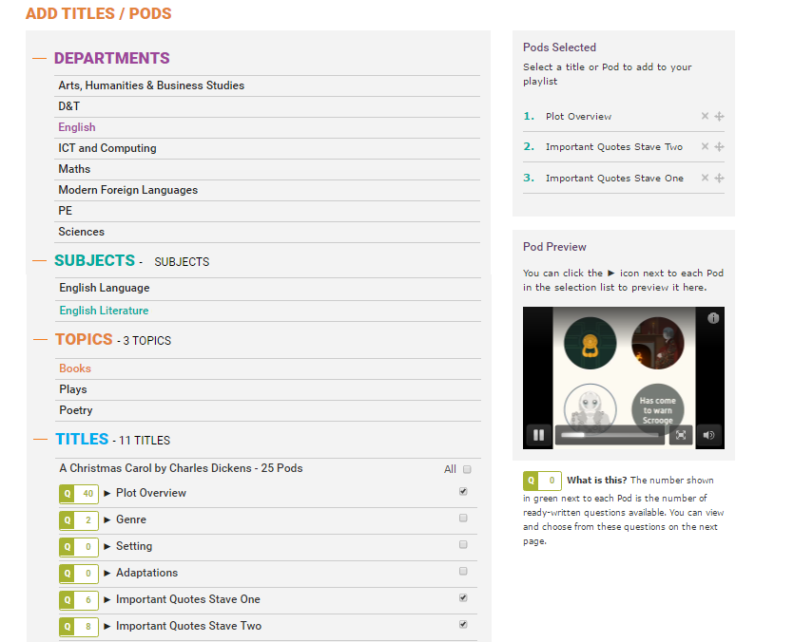

2. Pods you’ve selected appear here
Include Pods across subjects. E.g. a History Pod may give context to an English Literature poem.
3. Watch a preview of any Pod here
1. Lists of topics will be filtered by exam board

Slide 7

Step by Step – Setting an assignment
Select the Pods you want the students to watch
Choose from the recommended questions (edit existing or add your own)

Slide 8
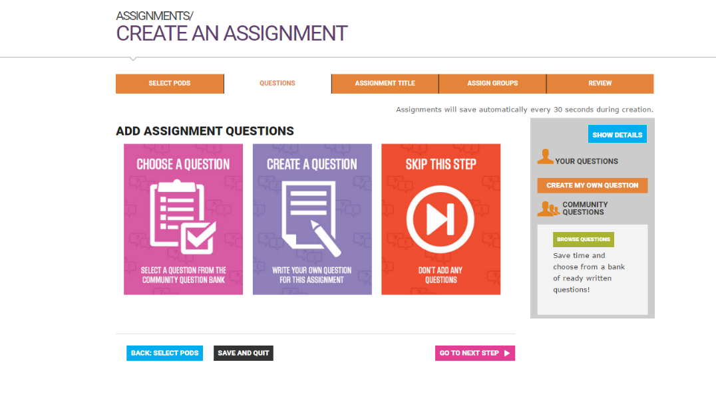
1. Here you can add pre-written questions
2. Use if you prefer the students just to watch the Pods
2. Create your own questions

Slide 9
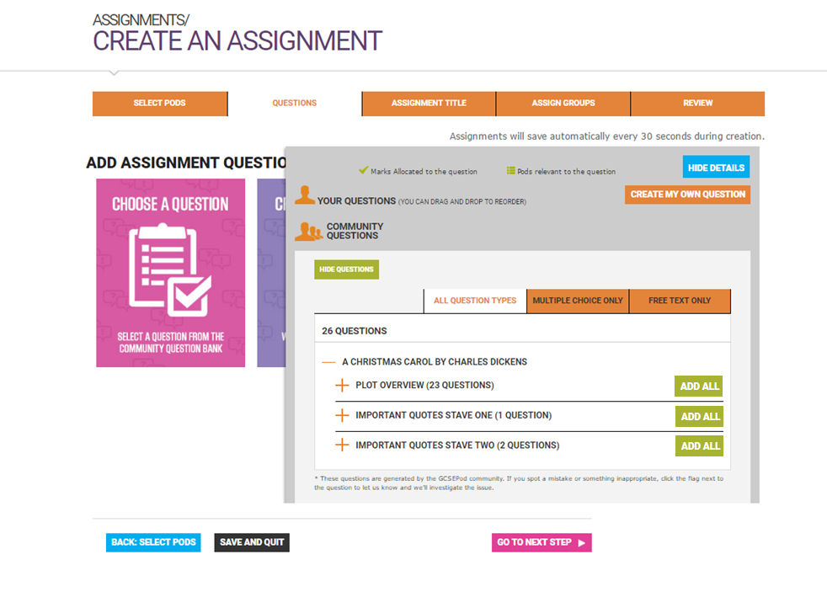

4. Add your own questions if you prefer
1. Click CHOOSE A QUESTION to get started
3. Filter by question
type
2. Click the + icons to reveal the questions

Slide 10
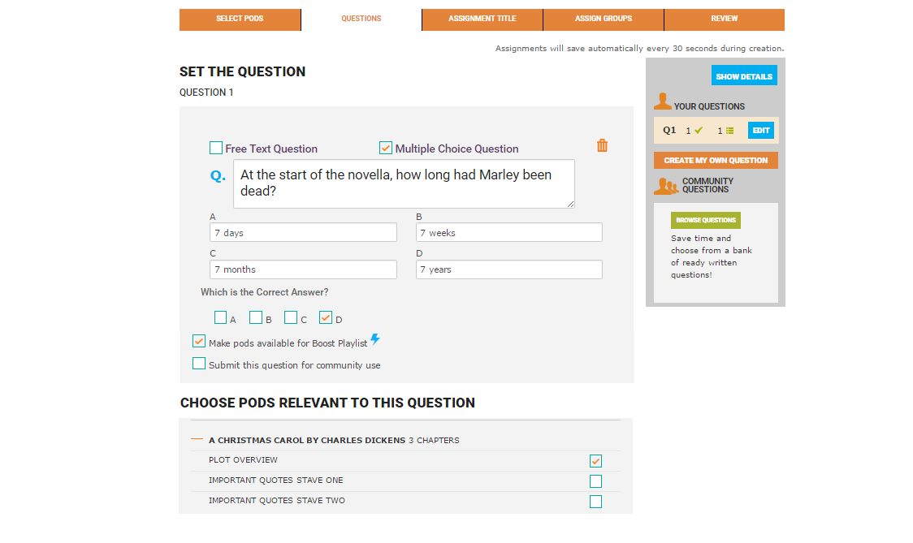
4. Write your own question
1. Your chosen question will appear here. Edit if you wish.
3. Add more questions from the bank
2. You can see which Pods are relevant to the question. These will be added to the student’s boost playlist if they get this question wrong.
This will be prefilled if the question is from the question bank.

Slide 11
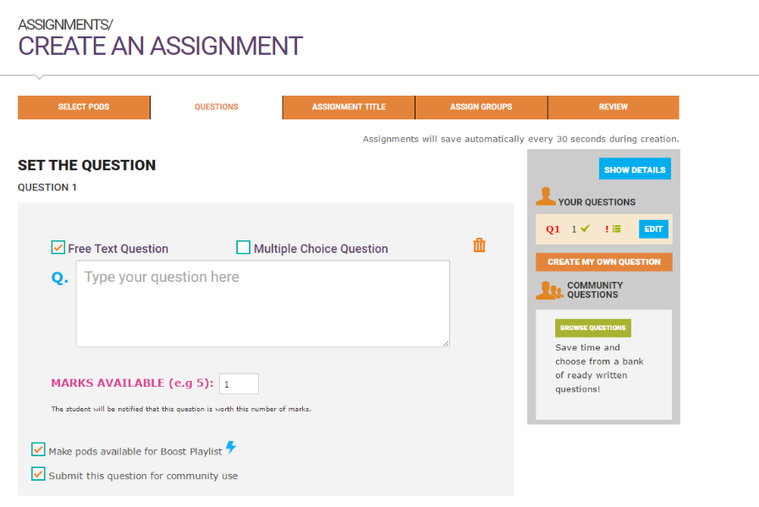
1. When creating or editing free text questions, you can choose how many marks to award to each question.

Slide 12

Step by Step – Setting an assignment
Select the Pods you want the students to watch
Choose from the recommended questions (edit existing or add your own)
Add some final information

Slide 13
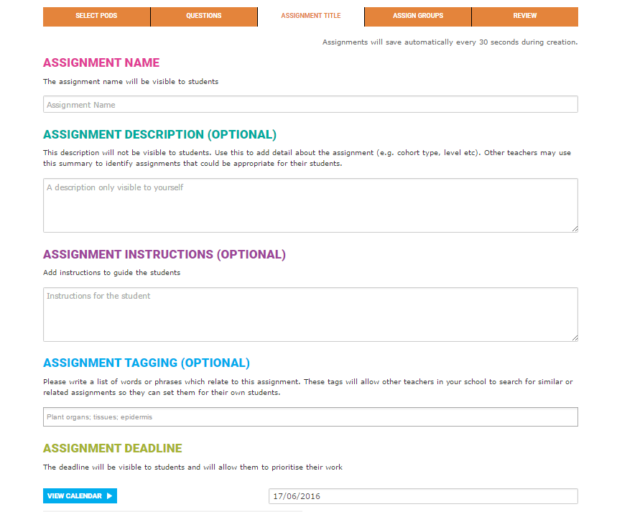
1. Give your assignment a name
Include web links in the assignment instructions to direct students to other online resources.
2. Add information which may help a colleague duplicating this assignment. E.g. the year group for which it is appropriate.
3. Add a deadline

Slide 14

Step by Step – Setting an assignment
Select the Pods you want the students to watch
Choose from the recommended questions (edit existing or add your own)
Add some final information
Choose which students will receive the assignment

Slide 15
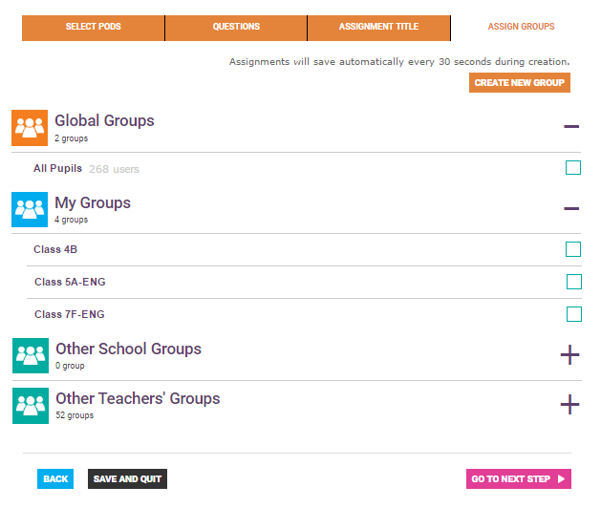
1. Create a new group, for example an intervention group
Set assignments for students that have missed lessons, or intervention groups.
1. Tick the box next to the group to select it

Slide 16
What the students see…

Slide 17

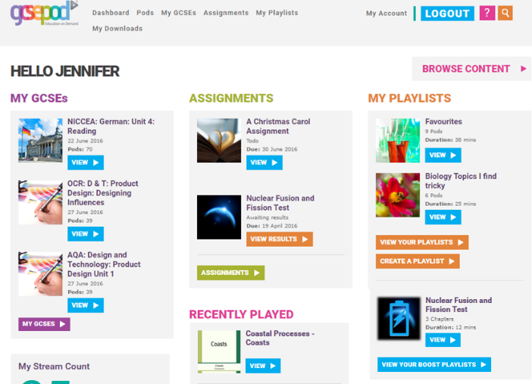
Success! The assignment appears on each student’s dashboard

Slide 18
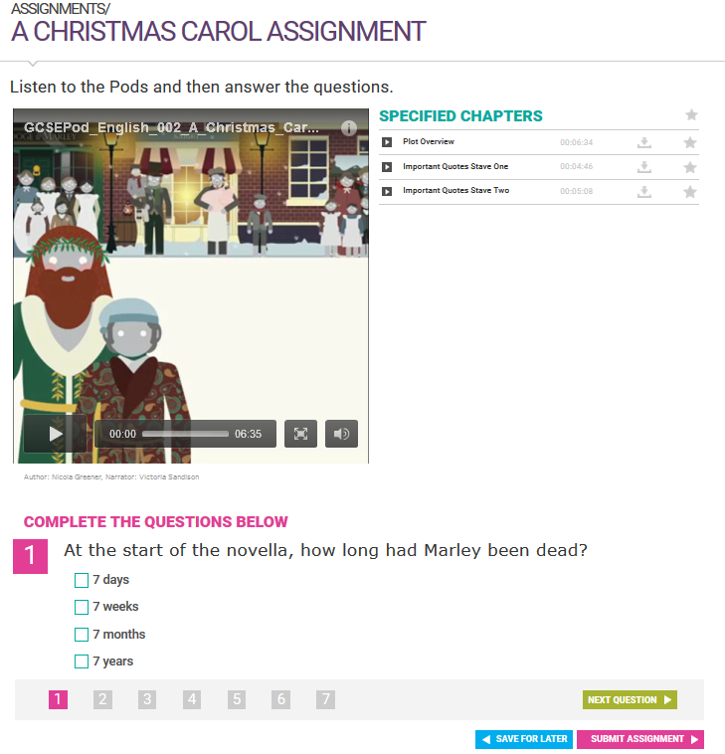

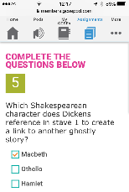
1. Student can use any device
2. Student watches the Pods here
3. Questions are completed here

Slide 19


Slide 20
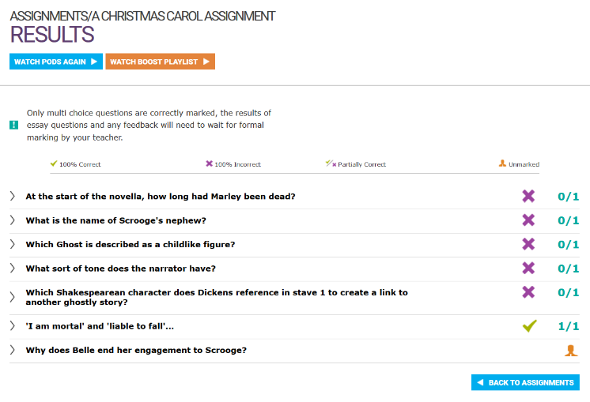
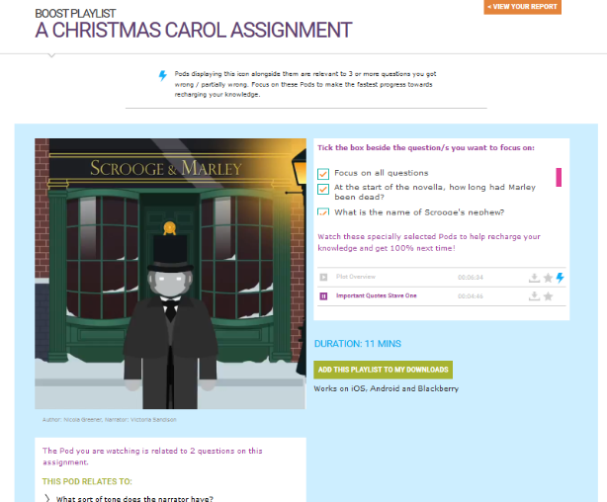
BOOST PLAYLIST
Student strengthens their knowledge by revising Pods relevant to their identified weak areas.
RESULTS PAGE
Student can see their knowledge gaps and review correct answers.

Slide 21
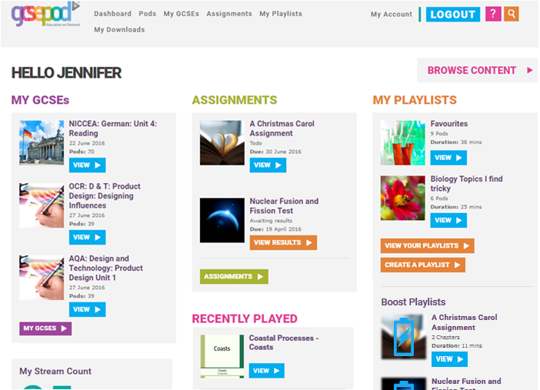
The student can revisit their Boost playlist at any time from the home screen.

Slide 22

Viewing responses and marking…

Slide 23

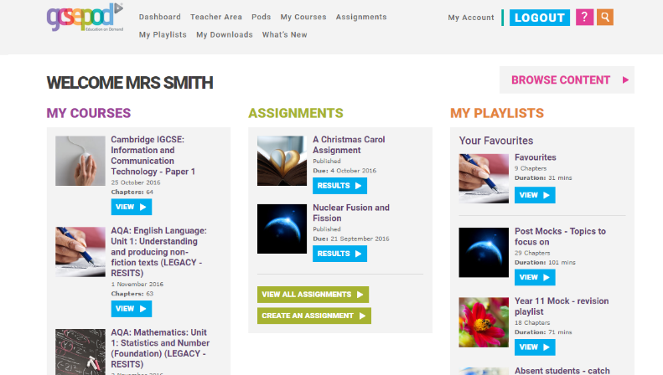
Click results

Slide 24

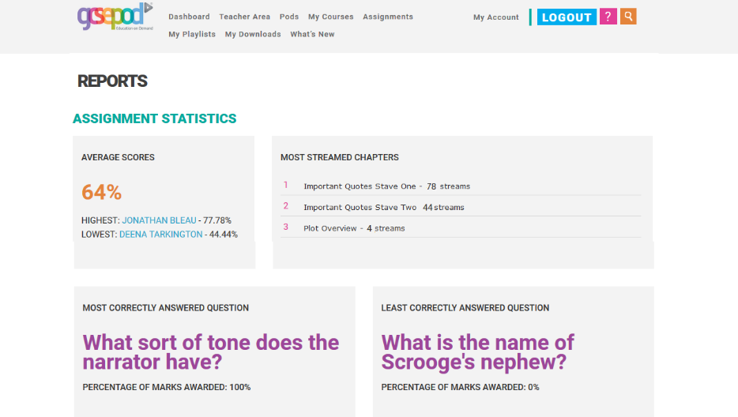
Group analysis helps you identify students that may need extra support.
You can also view questions students struggled with or excelled at answering.

Slide 25
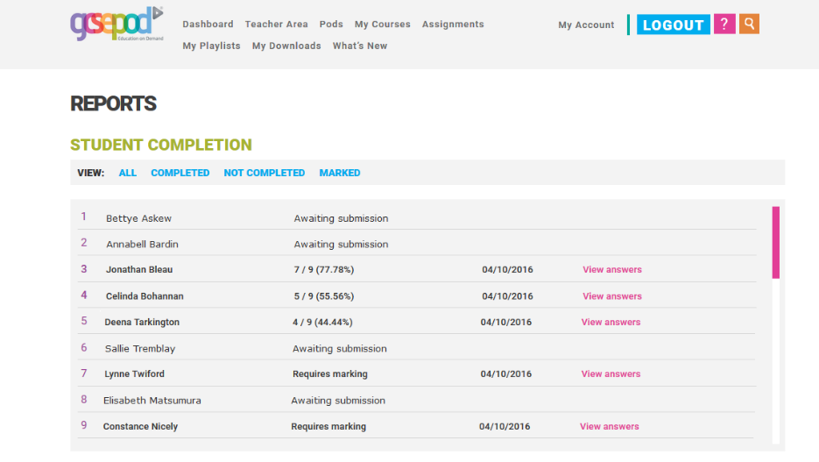
Click “view answers” to mark free text questions and leave feedback on multi-choice questions

Slide 26
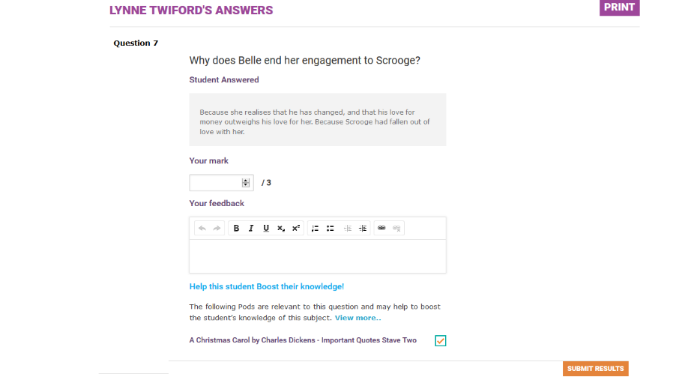
1. Mark free text questions
(Multi-choice questions are marked automatically)
2. Leave written feedback on free text and multi-choice questions.
This can be seen by the student.

Slide 27
Benefits
Save time by accessing pre-written questions and self marking assignments.
Maximise all available learning time by automatically providing students with the resources to fill knowledge gaps before they attend your next lesson.
Encourage an independent learning style.
Take advantage of students’ attention when they have just completed an assignment by automatically providing them with the materials to strengthen their knowledge immediately.
Identify students’ weakest areas and automatically generate personalised learning playlists. This avoids students falling into the bear trap of revising what they already know.
Ensure students fully understand a topic by providing them with materials that don’t encourage memorising of question and answer but inspire students to learn the context around a question. This prepares the student to apply their knowledge in any situation.
Prepare students for differently phrased questions in exams by using questions written by other teachers teaching the same exam board syllabus.
Collaborate with your colleagues by sharing and duplicating existing assignments.

Slide 28
Schools with the highest number of assignments are consistently in our top 20% of schools for overall GCSEPod usage.
TOP 10 SCHOOLS BASED ON NUMBER OF ASSIGNMENTS SET IN ACADEMIC YEAR 2015/16
School | Number of Assignments Set (Academic year 2015/16) | Total Pods Watched (Academic year 2015/16) | Place on leaderboard out of 700 schools
School name anonymised | 502 | 12,417 | 80
School name anonymised | 364 | 23,829 | 15
School name anonymised | 343 | 22,945 | 17
School name anonymised | 313 | 18,202 | 33
School name anonymised | 168 | 15,036 | 51
School name anonymised | 141 | 9,952 | 145
School name anonymised | 136 | 10,000 | 143
School name anonymised | 135 | 11,863 | 90
School name anonymised | 129 | 38,659 | 3
School name anonymised | 125 | 9,879 | 148

Slide 29
Want to know more?
How to set an assignment:
https://www.youtube.com/watch?v=2Xu01hdfdgE
How to mark an assignment:
https://www.youtube.com/watch?v=ELjHzwrWntY

